Slide 1
Linear Programming
Yuchun Ma
myc@tsinghua.edu.cn

Slide 2
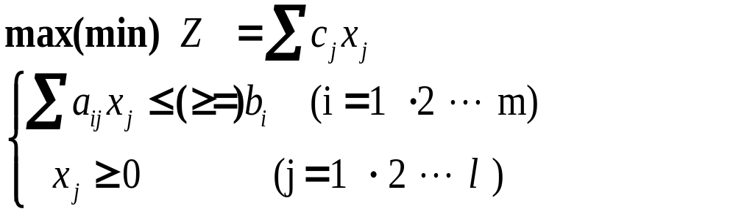
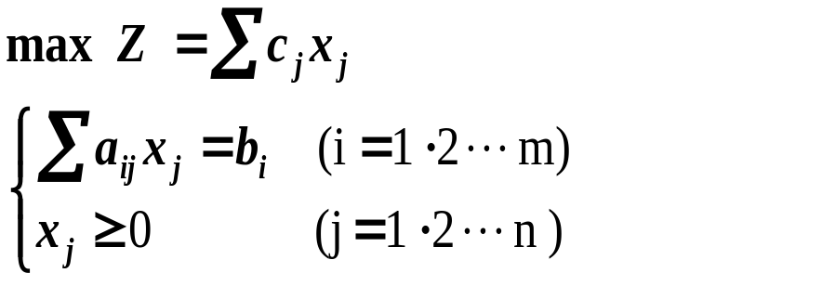


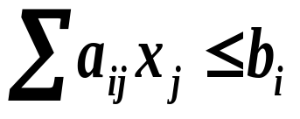
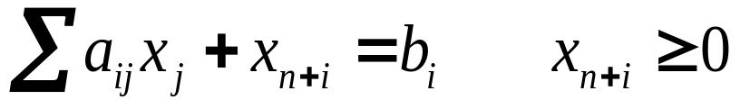
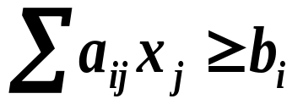
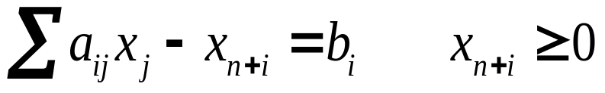
Transformation：
  Objective: min/max → max
  Variables: all the variables are non-negative
  x_{k} has no constraint then let x_{k}=x_{k}’-x_{k}’’, and x_{k}’, x_{k}’’ are non-negative
  Constant term: non-negative
  turn b_{n} to –b_{n} by multiplying (-1) on both sides
  Constraints : replace non-equalities with equalities
  non-negative slack variables
Augmented Form
Multiply -1

Slide 3
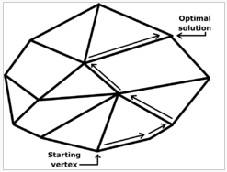
Simplex Method
Begin the search at an extreme point (i.e., a basic feasible solution).
  If X＝(x₁ ... x_{n} x_{n+1} ··· x_{n+m})^{T} is an extreme point, then the coefficient vectors of non-zero variables x_{i} are linear independent.
2. Determine if the movement to an adjacent extreme point can improve on the objective function. If not, the current solution is optimal. If, however, improvement is possible, then proceed to the next step.
3. Move to the adjacent extreme point which offers (or, perhaps, appears to offer) the most improvement in the objective function.
4. Continue steps 2 and 3 until the optimal solution is found or it can be shown that the problem is either unbounded or infeasible.

Slide 4
Iterations：
Simplex Method
Find a feasible solution
Optimal?
Y
Optimal
solution
N
Finish
Find another feasible
solution with larger value

Slide 5
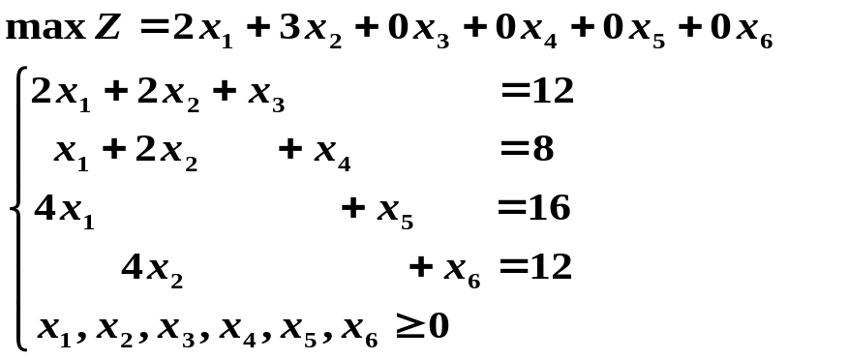
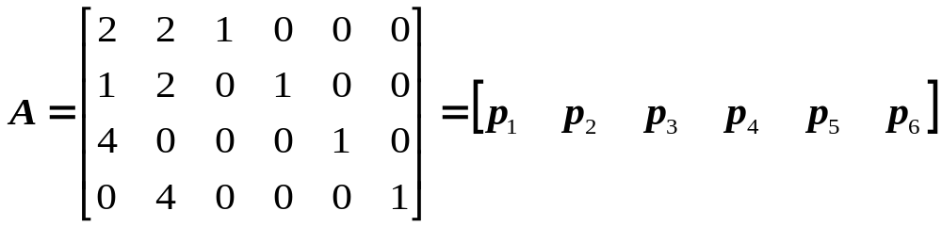
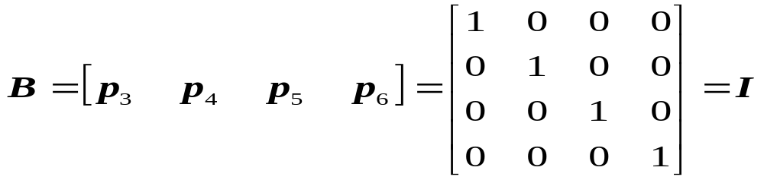
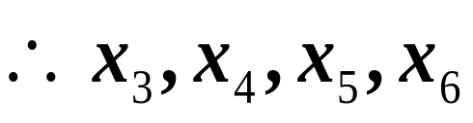
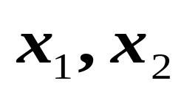
Basic vectors
are the basic variables
Are non-basic variables
Accordingly, the feasible solution is（0 0 12 8 16 12）
while the objective is Z = 0

Slide 6
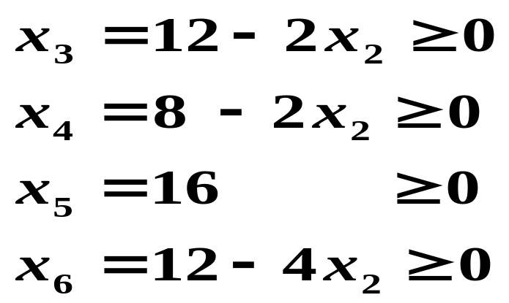
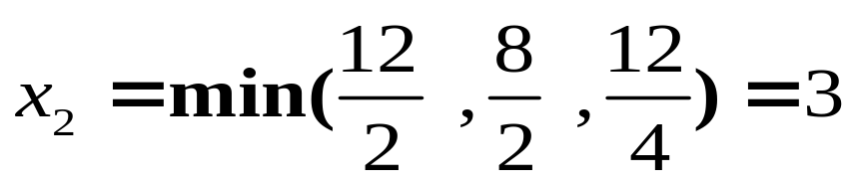

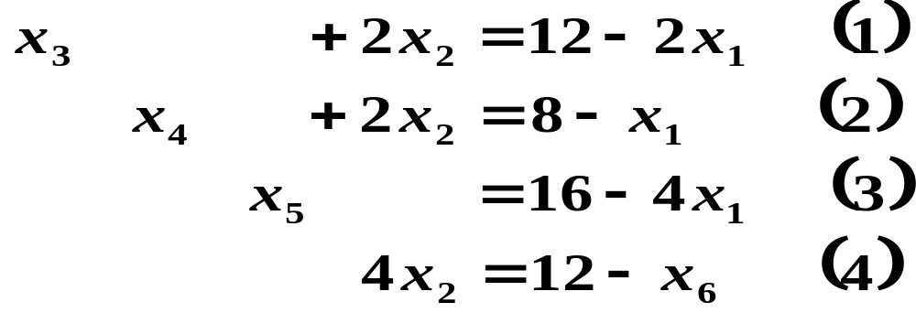
b
12
8
16
12
A
⎡
2
2
1
0
0
0
⎤
⎢
⎥
⎢
1
2
0
1
0
0
⎥
A
=
⎢
4
0
0
0
1
0
⎥
⎢
⎥
Let x₂ to be non-zero (to be basic variable)
x₁=0, some other variable should be 0 among x₃,x₄,x₅,x₆
⎣
0
4
0
0
0
1
⎦
All variables non-negative
x₆=0, become non-basic variable to exchange with x₂
Then：

Slide 7

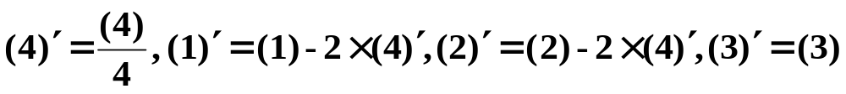
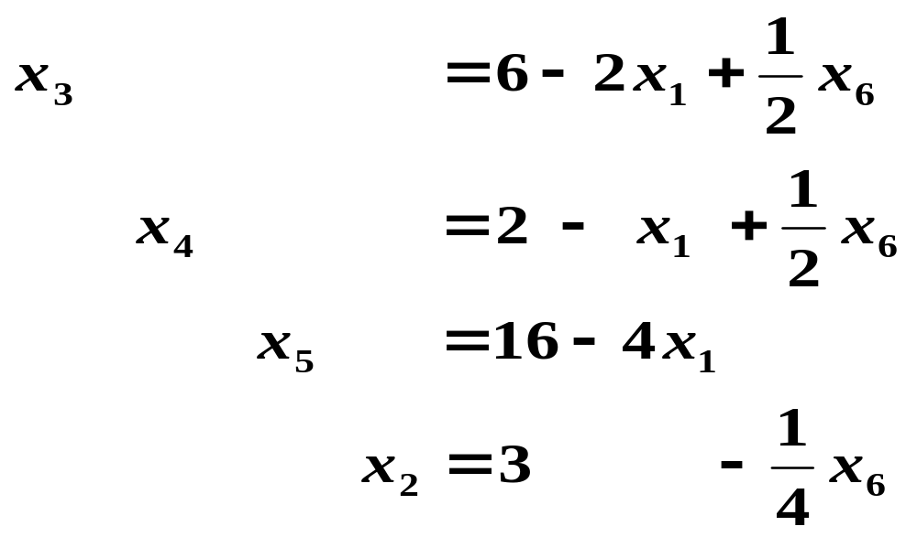
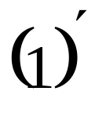
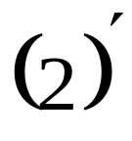
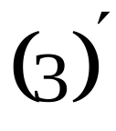

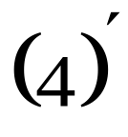
6
2
16
3
⎡
2
0
1
0
0
⎤
-0.5
⎢
1
0
0
1
0
⎥
⎢
-0.5
P
=
⎥
⎢
4
0
0
0
1
0
⎥
⎢
⎥
⎣
0
1
0
0
0
0.25
⎦
Gaussian elimination to transform the coefficients for x₂ into I：

Slide 8
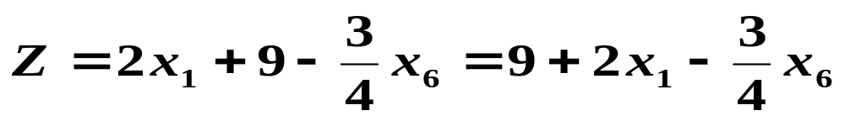
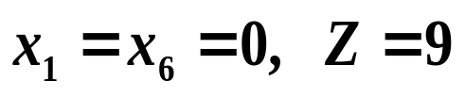
（0，3，6，2，16，0）
we can increase x₁ to enlarge Z.
c_{j} |  |  | 2 3 0 0 0 0
c_{B} | x_{B} | P₀ | P₁ P₂ P₃ P₄ P₅ P₆
0 0 0 3 | x₃ x₄ x₅ x₂ | 6 2 16 3 | 2 0 1 0 0 -1/2 1 0 0 1 0 -1/2 4 0 0 0 1 0 0 1 0 0 0 1/4
-Z |  | -9
6/2
2
16/4
－
2 0 0 0 0 -3/4

Slide 9
Solves LP problems by constructing a feasible solution at a vertex of the polytope and then walking along a path on the edges of the polytope to vertices with non-decreasing values of the objective function until an optimum is reached.
    Locate an extreme point of the feasible region.
    Examine each boundary edge intersecting at this point to see whether movement along any edge increases the value of the objective function.
    If the value of the objective function increases along any edge, move along this edge to the adjacent extreme point. If several edges indicate improvement, the edge providing the greatest rate of increase is selected.
    Repeat steps 2 and 3 until movement along any edge no longer increases the value of the objective function.
A
b
12
8
16
12
P
P0
6
2
16
3
Objective： Z=C_{B}P0= C_{B}B⁻¹b
⎡
2
2
1
0
0
0
⎤
⎡
2
0
1
0
0
⎤
-0.5
⎢
⎥
⎢
⎥
⎢
1
2
0
1
0
0
⎥
⎢
1
0
0
1
0
-0.5
A
=
Transformation with B⁻¹
P
=
⎥
⎢
4
0
0
0
1
0
⎥
⎢
4
0
0
0
1
0
⎥
⎢
⎥
⎢
⎥
⎣
0
4
0
0
0
1
⎦
⎣
0
1
0
0
0
0.25
⎦
B⁻¹( b A₁ A₂ … A_{n+m} )＝( P0 P1 P2 … Pn+m )．

Slide 10

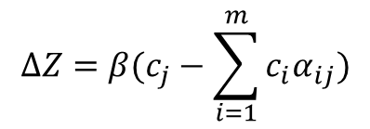
b
12
8
16
12
A
⎡
2
2
1
0
0
0
⎤
⎢
⎥
⎢
1
2
0
1
0
0
⎥
A
=
⎢
4
0
0
0
1
0
⎥
⎢
⎥
Let x₂ to be non-zero (to be basic variable)
x₁=0, some other variable should be 0 among x₃,x₄,x₅,x₆
⎣
0
4
0
0
0
1
⎦
All variables non-negative
x₆=0, become non-basic variable to exchange with x₂
Then：
Z(X₁)

Slide 11
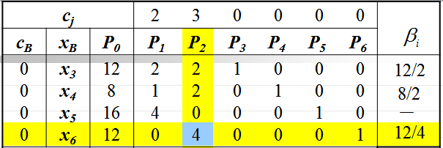
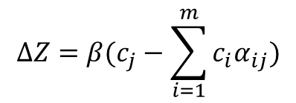

c_{j} |  |  | 2 3 0 0 0 0
c_{B} | x_{B} | P₀ | P₁ P₂ P₃ P₄ P₅ P₆
0 0 0 | x₃ x₄ x₅
6
2
0
1
0
0
-1/2
2
1
0
0
1
0
0
-1/2
16
4
0
0
0
1
0
3
x₂
3
0
1
0
0
0
1/4
-Z
-9
2 0 0 0 0 -3/4

Slide 12
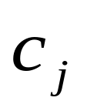
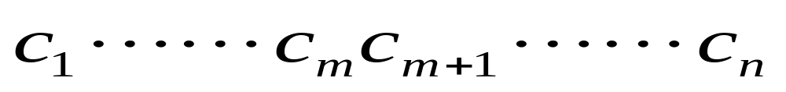


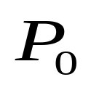
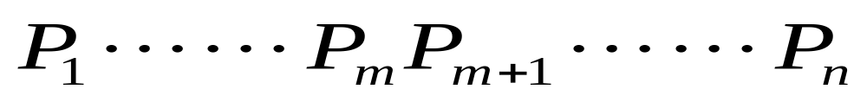



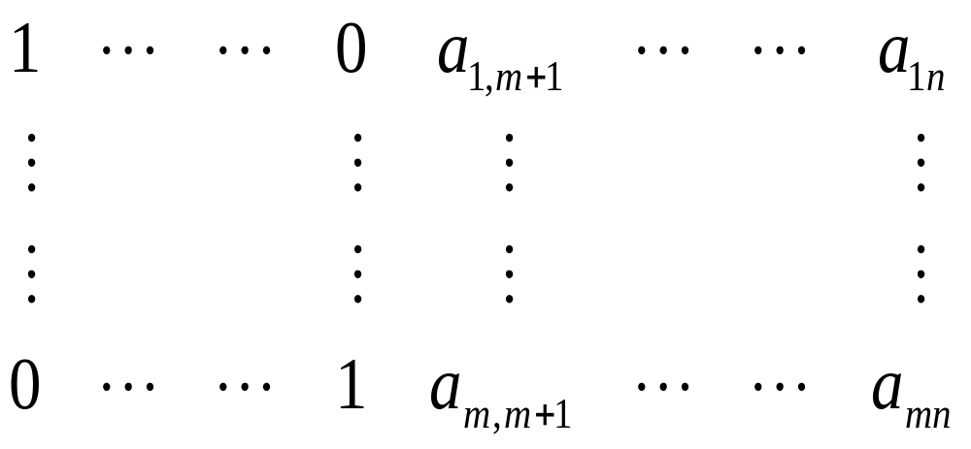
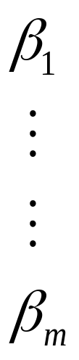

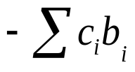

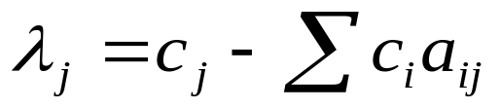
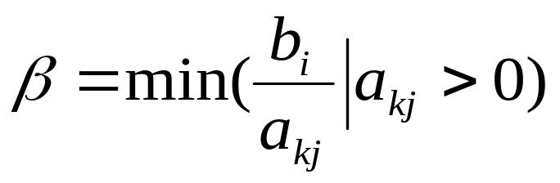
Entering Column
Leaving row
P₀ remains non-negative

Slide 13
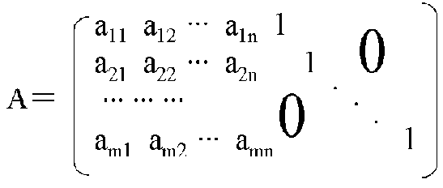

Find a feasible solution
Optimal?
Y
Optimal
solution
λ_{j} <0
N
Finish
Find another feasible
solution with larger value
c₁c₂……c_{n+m}
B⁻¹( b A₁ A₂ … A_{n+m} )＝( P₀ P₁ P₂ … P_{n+m} )．
1
1
1
X_{B}
C_{B}
β
-Z=-C_{B}P₀
λ_{j} =c_{j}－CBP_{j}

Slide 14
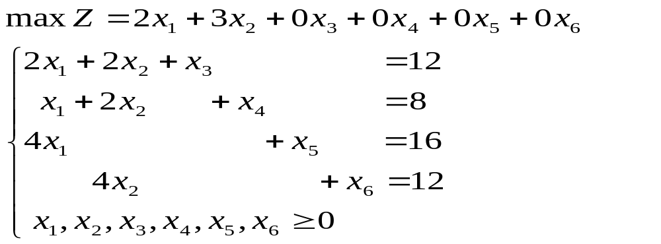
Example：
c_{j} |  |  | 2 3 0 0 0 0
c_{B} | x_{B} | P₀ | P₁ P₂ P₃ P₄ P₅ P₆
0 0 0 0 | x₃ x₄ x₅ x₆ | 12 8 16 12 | 2 2 1 0 0 0 1 2 0 1 0 0 4 0 0 0 1 0 0 4 0 0 0 1
 |  | 0 | 2 3 0 0 0 0

Slide 15
c_{j} |  |  | 2 3 0 0 0 0
c_{B} | x_{B} | P₀ | P₁ P₂ P₃ P₄ P₅ P₆
0 0 0 0 | x₃ x₄ x₅ x₆ | 12 8 16 12 | 2 2 1 0 0 0 1 2 0 1 0 0 4 0 0 0 1 0 0 4 0 0 0 1
-Z |  | 0
12/2
8/2
－
12/4
2 3 0 0 0 0
c_{j} |  |  | 2 3 0 0 0 0
c_{B} | x_{B} | P₀ | P₁ P₂ P₃ P₄ P₅ P₆
0 0 0 | x₃ x₄ x₅
-Z
6
2
0
1
0
0
-1/2
2
1
0
0
1
0
0
-1/2
16
4
0
0
0
1
0
3
x₂
3
0
1
0
0
0
1/4
2 0 0 0 0 -3/4

Slide 16
c_{j} |  |  | 2 3 0 0 0 0
c_{B} | x_{B} | P₀ | P₁ P₂ P₃ P₄ P₅ P₆
0 0 0 3 | x₃ x₄ x₅ x₂ | 6 2 16 3 | 2 0 1 0 0 -1/2 1 0 0 1 0 -1/2 4 0 0 0 1 0 0 1 0 0 0 1/4
-Z |  | -9
6/2
2
16/4
－
2 0 0 0 0 -3/4
c_{j} |  |  | 2 3 0 0 0 0
c_{B} | x_{B} | P₀ | P₁ P₂ P₃ P₄ P₅ P₆
0 2 0 3 | x₃ x₁ x₅ x₂ | 2 2 8 3 | 0 0 1 -2 0 1/2 1 0 0 1 0 -1/2 0 0 0 -4 1 2 0 1 0 0 0 1/4 | 4 － 4 12
-Z |  | -13 | 0 0 0 -2 0 1/4
degradation

Slide 17
c_{j}
2 3 0 0 0 0
c_{B}
x_{B}
P₀
P₁ P₂ P₃ P₄ P₅ P₆
0
2
0
3
x₃
x₁
x₅
x₂
2
2
8
3
0 0 1 -2 0 1/2
1 0 0 1 0 -1/2
0 0 0 -4 1 2
0 1 0 0 0 1/4
4
－
4
12
-Z
-13
0 0 0 -2 0 1/4
c_{j} |  |  | 2 3 0 0 0 0
c_{B} | x_{B} | P₀ | P₁ P₂ P₃ P₄ P₅ P₆
0 2 0 3 | x₆ x₁ x₅ x₂ | 4 4 0 2 | 0 0 2 -4 0 1 1 0 1 -1 0 0 0 0 -4 4 1 0 0 1 -1/2 1 0 0
-Z |  | -14 | 0 0 -1/2 -1 0 0
x1=4,x2=2
Zmax=14

Slide 18
c_{j}
2 3 0 0 0 0
c_{B}
x_{B}
P₀
P₁ P₂ P₃ P₄ P₅ P₆
0
2
0
3
x₃
x₁
x₅
x₂
2
2
8
3
0 0 1 -2 0 1/2
1 0 0 1 0 -1/2
0 0 0 -4 1 2
0 1 0 0 0 1/4
4
－
4
12
-Z
-13
0 0 0 -2 0 1/4
c_{j} |  |  | 2 3 0 0 0 0
c_{B} | x_{B} | P₀ | P₁ P₂ P₃ P₄ P₅ P₆
0 2 0 3 | x₃ x₁ x₆ x₂ | 0 4 4 2 | 0 0 1 -1 -1/4 0 1 0 0 0 1/4 0 0 0 0 -2 1/2 1 0 1 0 1/2 -1/8 0
-Z |  | -14 | 0 0 0 -3/2 -1/8 0
X1=4,x2=2
Zmax=14

Slide 19
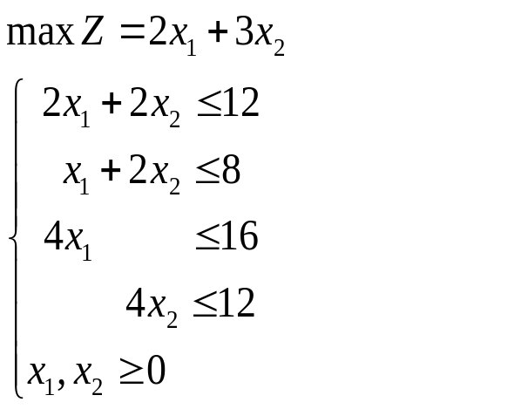
x1=4, x2=2
The optimal solution:
Z=2*4+3*2=14
2*4+2*2=12
4+2*2=8
4*4=16
4*2=8<12

Slide 20
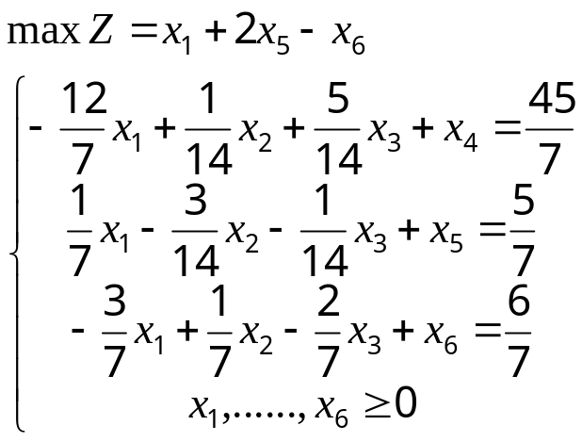
c_{j} |  |  | 1 0 0 0 2 -1
c_{B} | x_{B} | P₀ | P₁ P₂ P₃ P₄ P₅ P₆
0 2 -1 | x₄ x₅ x₆ | 45/7 5/7 6/7 | -12/7 1/14 5/14 1 0 0 1/7 -3/14 -1/14 0 1 0 -3/7 1/7 -2/7 0 0 1
-Z |  | -4/7
90
-10/3
6
2/7 4/7 -1/7 0 0 0

Slide 21
c_{j} |  |  | 1 0 0 0 2 -1
c_{B} | x_{B} | P₀ | P₁ P₂ P₃ P₄ P₅ P₆
0 2 -1 | x₄ x₅ x₆ | 45/7 5/7 6/7 | -12/7 1/14 5/14 1 0 0 1/7 -3/14 -1/14 0 1 0 -3/7 1/7 -2/7 0 0 1
-Z |  | -4/7
90
-10/3
6
2/7 4/7 -1/7 0 0 0
c_{j} |  |  | 1 0 0 0 2 -1
c_{B} | x_{B} | P₀ | P₁ P₂ P₃ P₄ P₅ P₆
0 2 0 | x₄ x₅ x₂
-Z
6 -3/2 0 1/2 1 0 -1/2
2 -1/2 0 -1/2 0 1 0
6 -3 1 -2 0 0 7
2 0 1 0 0 0
Since c1－z1＞0，But P1＝(－3/2 ,－1/2,－3)^{T}, all less than 0，
unbounded solution．

Slide 22
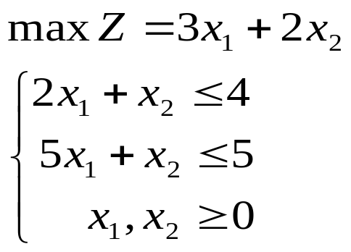
Move to the adjacent extreme point which offers (or, perhaps, appears to offer) the most improvement in the objective function.
c_{j} |  |  | 3 2 0 0
c_{B} | x_{B} | P₀ | P₁ P₂ P₃ P₄
0 0 | x₃ x₄ | 4 5 | 2 1 1 0 5 1 0 1
Z |  | 0
2
(1)
1
3 2 0 0

Slide 23
c_{j} |  |  | 3 2 0 0
c_{B} | x_{B} | P₀ | P₁ P₂ P₃ P₄
0 0 | x₃ x₄ | 4 5 | 2 1 1 0 5 1 0 1
Z |  | 0
2
1
3 2 0 0
c_{j} |  |  | 3 2 0 0
c_{B} | x_{B} | P₀ | P₁ P₂ P₃ P₄
0 3 | x₃ x₁
Z
2 0 3/5 1 -2/5
10/3
(2)
1 1 1/5 0 1/5
5
3
0 7/5 0 -3/5

Slide 24
c_{j} |  |  | 3 2 0 0
c_{B} | x_{B} | P₀ | P₁ P₂ P₃ P₄
0 3 | x₃ x₁ | 2 1 | 0 3/5 1 -2/5 1 1/5 0 1/5
Z |  | 3
10/3
5
0 7/5 0 -3/5
c_{j} |  |  | 3 2 0 0
c_{B} | x_{B} | P₀ | P₁ P₂ P₃ P₄
2 3 | x₂ x₁
Z
(3)
10/3 0 1 5/3 -2/3
-5
1/3 1 0 -1/3 1/3
1
23/3 0 0 -7/3 1/3

Slide 25
c_{j} |  |  | 3 2 0 0
c_{B} | x_{B} | P₀ | P₁ P₂ P₃ P₄
2 3 | x₂ x₁ | 10/3 1/3 | 0 1 5/3 -2/3 1 0 -1/3 1/3
Z |  | 23/3
-5
1
0 0 -7/3 1/3
c_{j} |  |  | 3 2 0 0
c_{B} | x_{B} | P₀ | P₁ P₂ P₃ P₄
2 0 | x₂ x₄
Z
4 2 1 1 0
(4)
1 3 0 -1 1
8 -1 0 -2 0
x1=0,x2=4,maxZ = 8

Slide 26
How about to choose the lessλ_{j}
c_{j} |  |  | 3 2 0 0
c_{B} | x_{B} | P₀ | P₁ P₂ P₃ P₄
0 0 | x₃ x₄ | 4 5 | 2 1 1 0 5 1 0 1
Z |  | 0
4
5
3 2 0 0
c_{j} |  |  | 3 2 0 0
c_{B} | x_{B} | P₀ | P₁ P₂ P₃ P₄
2 0 | x₂ x₄
Z
(1)
4 2 1 1 0
1 3 0 -1 1
8 -1 0 -2 0
x1=0, x2=4,maxZ = 8

Slide 27
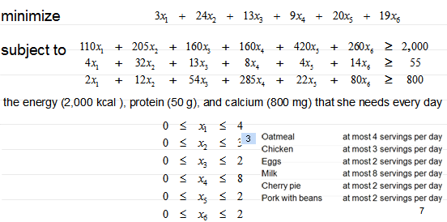
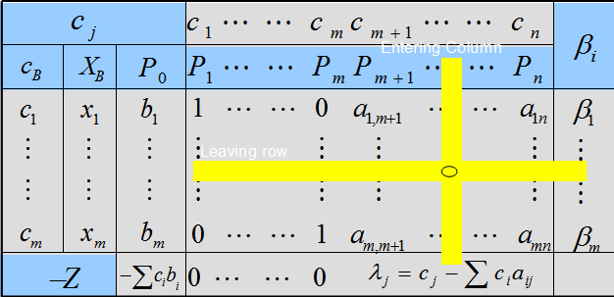
“The most improvement in the objective function” can not guarantee the least number of iterations.
How to choose the entering column?
First column with a positive cost.

Slide 28

Bland’s rule
Bland’s rule
  Robert G. Bland, now a professor of operations research at Cornell University.
  An algorithmic refinement of the simplex method
  Choose the lowest-numbered (i.e., leftmost) nonbasic column t with a positive cost.
http://en.wikipedia.org/wiki/Bland's_rule

Slide 29
LP solver
Lindo/Lingo
Matlab
Glpk: GNU Linear Programming Kit.
Excel
……

Slide 30


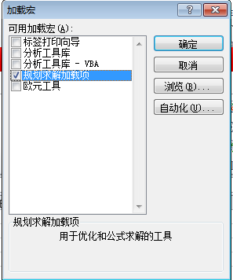


Excel 2010
Install programming
  “Option” ->“Add-in…” Choose programming

Slide 31
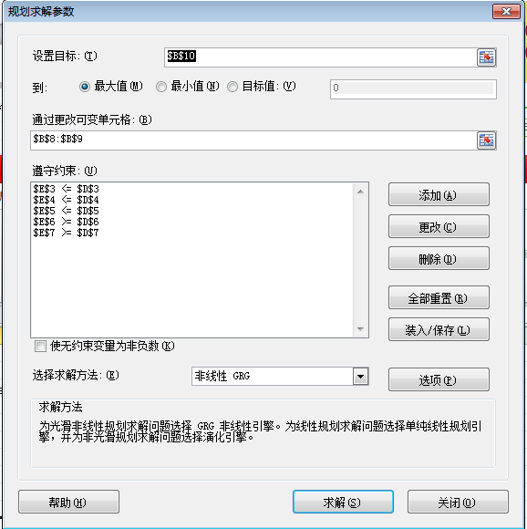
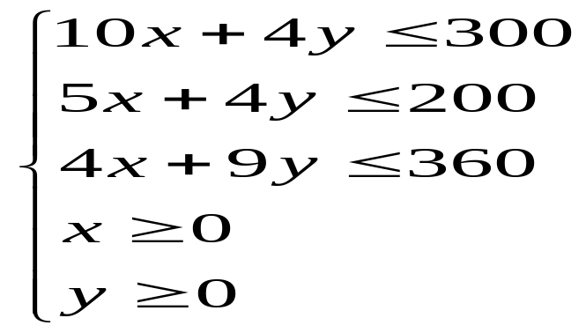
Programming
“Data”-> “Programming”
Max Z=600x+1000y

Slide 32
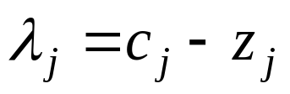
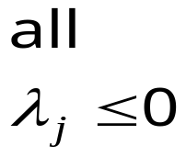



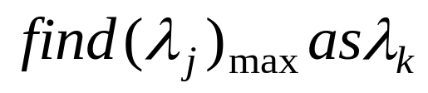
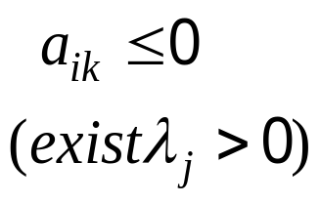



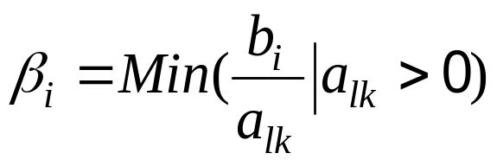


Simplex Method
Max
A
If no identity matrix in the augmented form?

Slide 33




Think over: What if the optimal solution for the slack variables are not “0”s?

Slide 34

Assignment
Solving the following linear program using simplex method

Slide 35
Thanks

